Slide 1
Real or Fake News
Tyler Anderson
Notes:
Hello My name is Tyler Anderson, and this is my Project on the Real and Fake news datasets

Slide 2


Can we predict fake news?
This Photo by Unknown Author is licensed under CC BY-NC-ND
Notes:
For this Project I want to see if predicting fake news shows any biases in the data itself. More specifically because of the nature of the topic and data it can be hard to be unbiased when it comes to the data for this. I will be examining two datasets that have news that was determined to be false and news that was determined to be true. One dataset will have all false news and the other having all true news. I want to analyze this dataset to try and see if I can predict the accuracy of a news being true or false based on the datasets provided. I hope to gain some insights on what makes some news false and others true and see if the discrepancy of true or false is a fine line between them. I also want to see if the dataset is biased as many of the datapoints in the datasets come from twitter and fake or real news to some may be subjective. For this project I will have to do some text analysis and try to find a way to determine fake or real news using text from twitter and official news sources. I might be able to try to determine the accuracy of fake or real news based on one or a couple words. I can use logistic regression to try to accomplish this. My main hypothesis is that the data is biased in some way and I can try to prove that by using an inconspicuous word like “the” and get a high accuracy by using regression models.
The main issue I can see is the potential bias of the datasets and an issue where it’s possible I could get too high of a score for example 99-100% accuracy. This might point to the dataset not being good at all. If there is bias, I want to see if it skews to fake or real news. Overall, I expect to have some interesting results as the current political climate has exasperated fake news and could possibly make it harder to predict. I expect to see some differences in the text analysis of the real and fake news datasets.

Slide 3
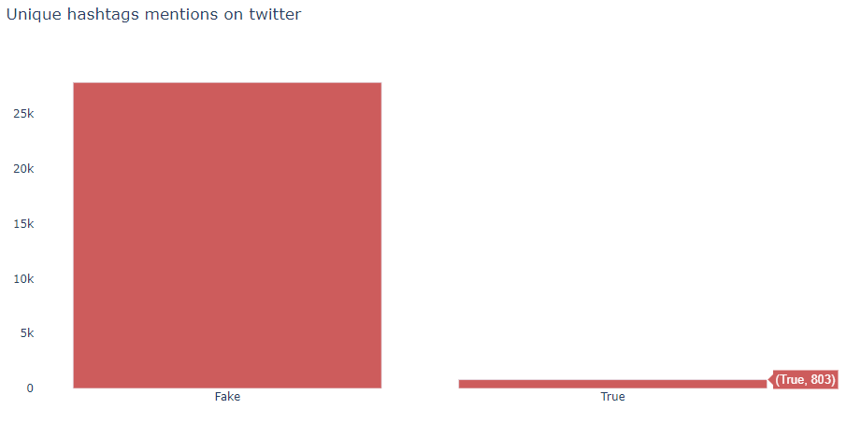
Analysis
To see the differentiation between true and false news I raised the number of quotes in false and true news. This led me to a unique visualization of @ mentions in twitter posts.
Notes:
Looking over the data we can see that the data is seemingly complete with no missing values or variables that are in the wrong format making this dataset easier to start working with. I first displayed the text of the first fake article and noticed that fake news has many mentions of quotes from twitter users. To see the differentiation between true and false news I raised the number of quotes in false and true news. This led me to a unique visualization of @ mentions in twitter posts.
We can clearly see that fake news has a much greater presence of @ mentions on twitter, the sources from which the real news was collected are from news articles mixed with twitter posts. This already leaves me to believe that the dataset is biased. However, the fact that @ mentions of users would not be enough to confirm that the data is not suitable for identification of fake news, since any preprocessing that removes @ would be able to decrease the bias. This led me to search for another aspect like the text size, to see if there is a lot of discrepancy between the texts

Slide 4
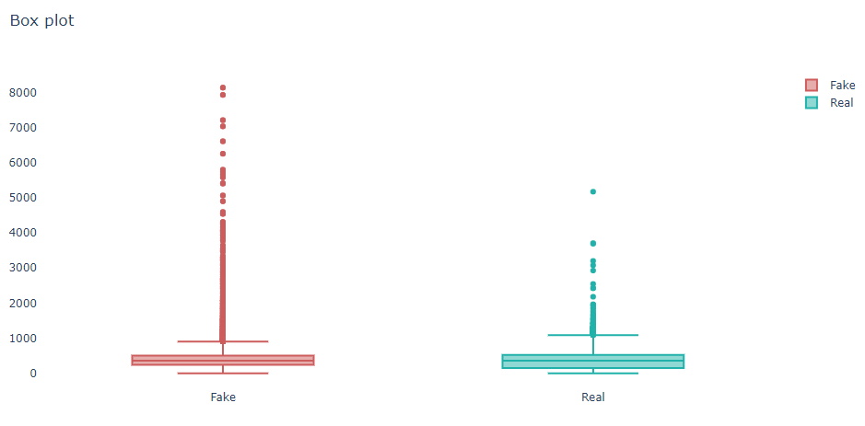
Analysis
Fake news in general has a lot more words than real ones
Fakes news is a mix of twitter posts and news this may justify the fact that they have more words
Notes:
After making the above plot fake news in general has a lot more words than real ones, which is kind of weird assuming real news has a tendency to bring details about events to inform the reader, however the fact that fakes news is a mix of twitter posts and news might justify the fact that they have more words. However, this might demonstrate the bias of the dataset as well and this can be resolved given that we would only work with fake news that was less than or equal to the news with more tokens, so this problem could be managed hypothetically. There may be more to this like the presence of duplicate news. This might be frequent in the data when the data is split since we would have both in the training and in the test, so it is possible to present the same samples for the model.

Slide 5
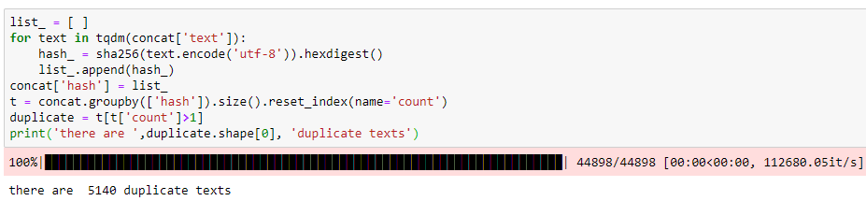
Analysis
Duplicate stories in the Fake news dataset
Notes:
After checking for duplicates we can clearly see some here. So, there is duplicate news in the dataset, but the ratio is not enough to allow the models to be as accurate, but it already contributes to the bias. At this point I wanted to go a little deeper in the data as there must be some aspect of writing for the words that allow a clear differentiation, so I will observe the presence of the tokens in the true and false news.

Slide 6
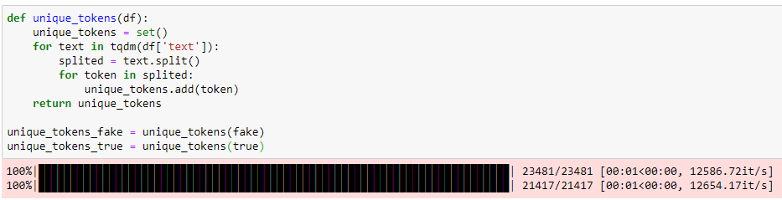
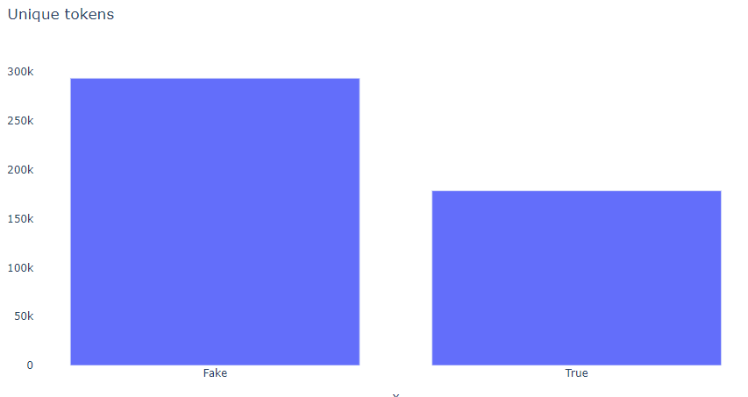
Analysis
Fake news has many different tokens than the real ones
Many uses of slang words and abbreviations
Notes:
When splitting tokens we can see that fake news has many different tokens than the real ones, this was to be expected assuming that inside the fake news there are twitter posts where people use, abbreviations , slang word and language in non-formal writing. I believe it is interesting to observe the occurrence of words that do not exist in the English language to see the difference between true and false news.

Slide 7
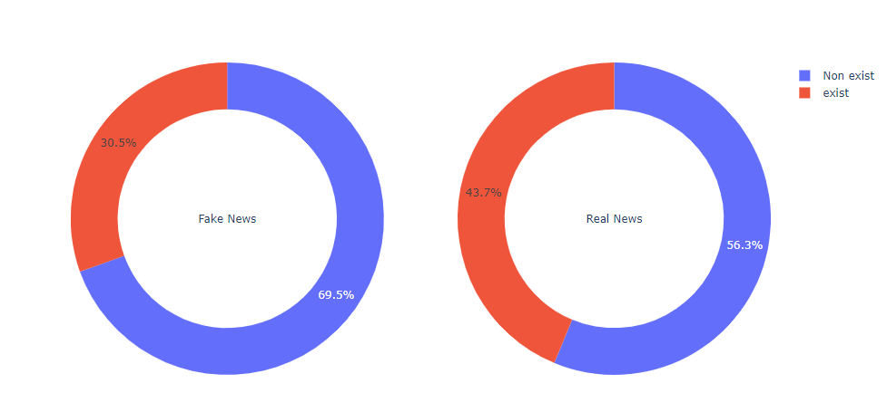
Analysis
70% of the words in the news fakes were not found in the dictionary used for verification
Notes:
In this plot more than 70% of the words in the news fakes were not found in the dictionary used for verification, it is important to make it clear that it is not a perfect dictionary but that it already brings this section that many words are really misspelled but so far everything that has been done has been in the data without any preprocessing, so let's apply a preprocessing that clears some characters and normalizes the text so that we can compare again.

Slide 8
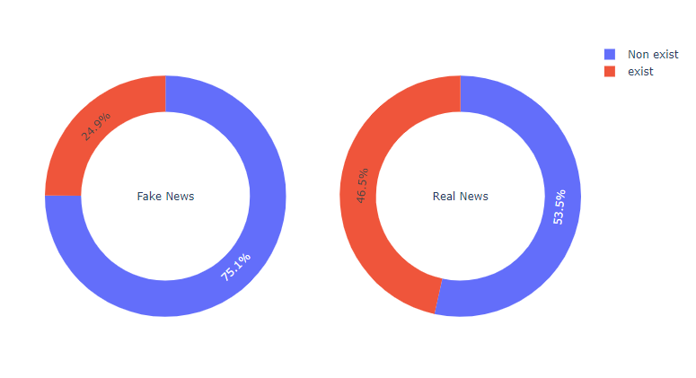
Analysis
Only showed the difference in the aspect of writing false news in relation to the real ones
Notes:
After applying some preprocessing, it only showed the difference in the aspect of writing false news in relation to the real ones. Since the words are so impactful let's see if there are any that stand out in relation to the others, raising the most relevant words of each type of news.

Slide 9
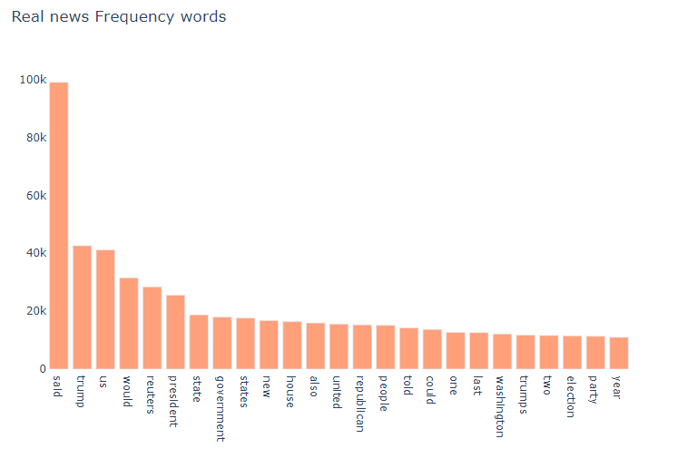
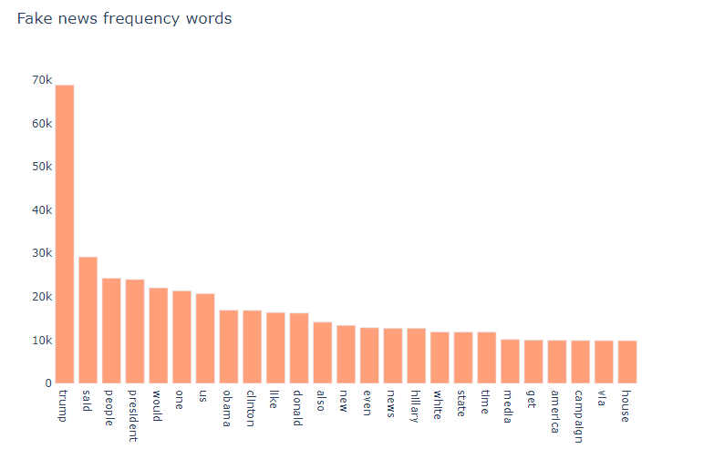
Analysis
The most frequent words of both types of news is not very different
Notes:
The most frequent words of both types of news is not very different, only the frequency is not enough to differentiate and demonstrate the bias of the data it is necessary to establish some order of importance, and for that I will use the chi-square hypothesis test to raise the most relevant words in the dataset. But first we will see to do this in relation to the words that are misspelled to evaluate their impact on the news.

Slide 10
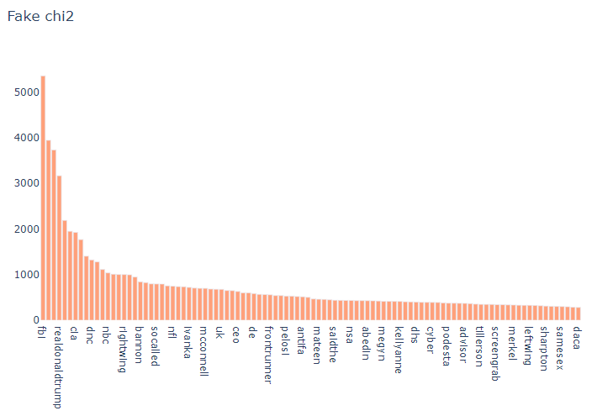
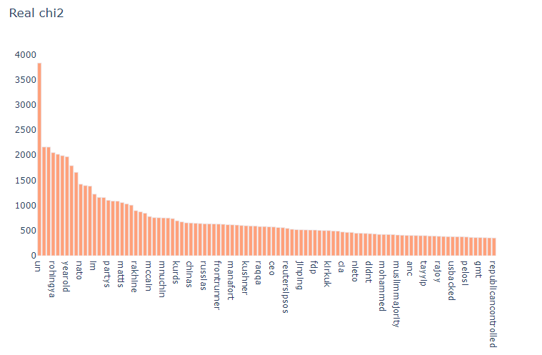
Analysis
We can see the words raised in general are acronyms that are not present in the dictionnary and words that are incorrect after preprocessing
Notes:
From the histogram here we can see the words raised in general are acronyms that are not present in the dictionary and words that are incorrect after preprocessing. Now we will analyze chi square in all dataset to see which words impact the data more in relation to its relevance

Slide 11
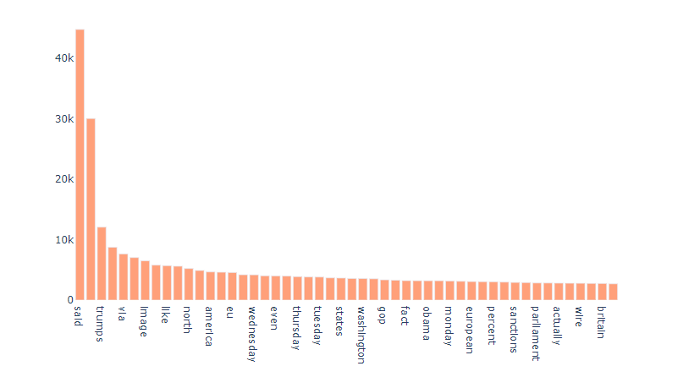
Analysis
The words ‘said’ and ‘reuters’ are words that have a great prominence in the data set
Notes:
The words ‘said’ and ‘reuters’ are words that have a great prominence in the data set. To better understand how the contexts of true and false news are, I will do the modeling by topics to understand if these words of greater prominence are present in well-defined topics. I can do this by generating multiple word clouds for fake news topics and real news topics.

Slide 12
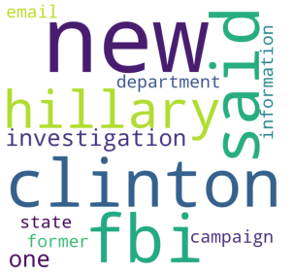
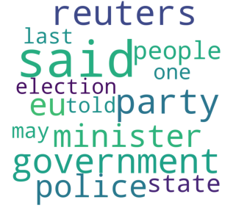
Word cloud
Topics created do not portray misspelled words or twitter users
Some subjects can be useful for identification of fake news
Fake
True
Notes:
It’s interesting how the topics created do not portray misspelled words or twitter users, demonstrating that at least the subjects covered can be useful for an eventual identification of fake news. To analyze the words and their impact on the classifier, I will select every 10% of the total of features and evaluate if reducing the number of words the classifier loses performance.

Slide 13
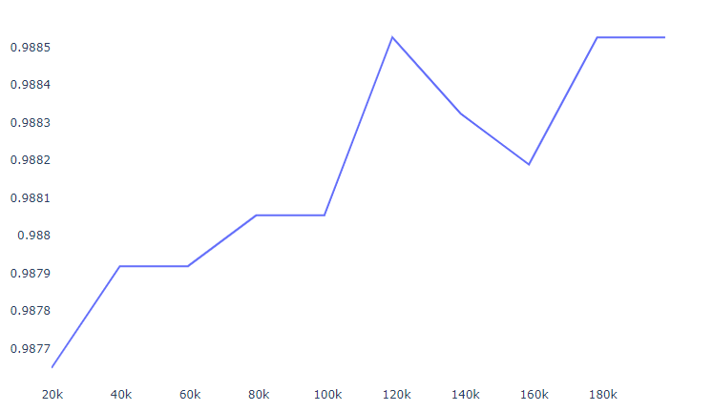
Analysis
Even with only 10% of the features, the classifier already shows a result of 98%
Notes:
Even with only 10% of the features, the classifier already shows a result of 98%, so there must be a set of words that make identification easy, I will only raise one feature according to chi squared and observe how a classifier based on this word behaves. The selected word was 'reuters', I will make a classifier based on whether the Reuters is present in real news and if it is not false. If we remove the Reuters word and replace it with an inconspicuous word like ‘said’ we reach a 70% accuracy. This shows how biased the fake news data is.

Slide 14
Conclusion
The dataset has many features that point to bias towards fake news
The fact that fake news is mixed with twitter posts points out a lack of care for the data
The dataset is extremely simple to be able to accept high results without much engineering
The use of a single word can allow almost 100% what is true or false news.
Notes:
The dataset has many features that point to bias towards fake news, apparently a poorly structured dataset that does not allow you to raise more consistent information in relation to real characteristics that fake news can present. The fact that fake news is mixed with twitter posts points out a lack of care for the data, generating a dataset that is extremely simple to be able to accept high results without much engineering. Resulting in the end the use of a single word can allow almost 100% what is true or false news.

